Slide 2
Committed Action in Practice: Identifying and Overcoming Client and Therapist Barriers to Committed Action
Sonja V. Batten, Ph.D.
Patricia A. Bach, Ph.D.
Daniel J. Moran, Ph.D.
Peer-reviewed ACT Trainers
Past-Presidents and Fellows, Association for Contextual Behavioral Science

Slide 3
Disclosures (support):
Relevant Financial Relationships:
Moran, Bach, and Batten all receive royalties from New Harbinger publications for a book co-written on a topic similar to the subject of this presentation
Batten employed by Booz Allen Hamilton
Bach employed by the Carter Psychology Center
Moran employed by Pickslyde Consulting and MidAmerican Psychological Institute

Slide 4
Disclosures (no support):
Daniel J. Moran, Sonja V. Batten, Patricia A. Bach
I have not received and will not receive any commercial support related to this presentation or the work presented in this presentation.
Relevant Nonfinancial Relationships
Moran, Bach, and Batten have all served as Past-President of the Association for Contextual Behavioral Science

Slide 5
References
The work we’ll be presenting today is based largely on:
Committed Action in Practice
Moran, Bach, & Batten (Context Press: 2018)

Slide 6
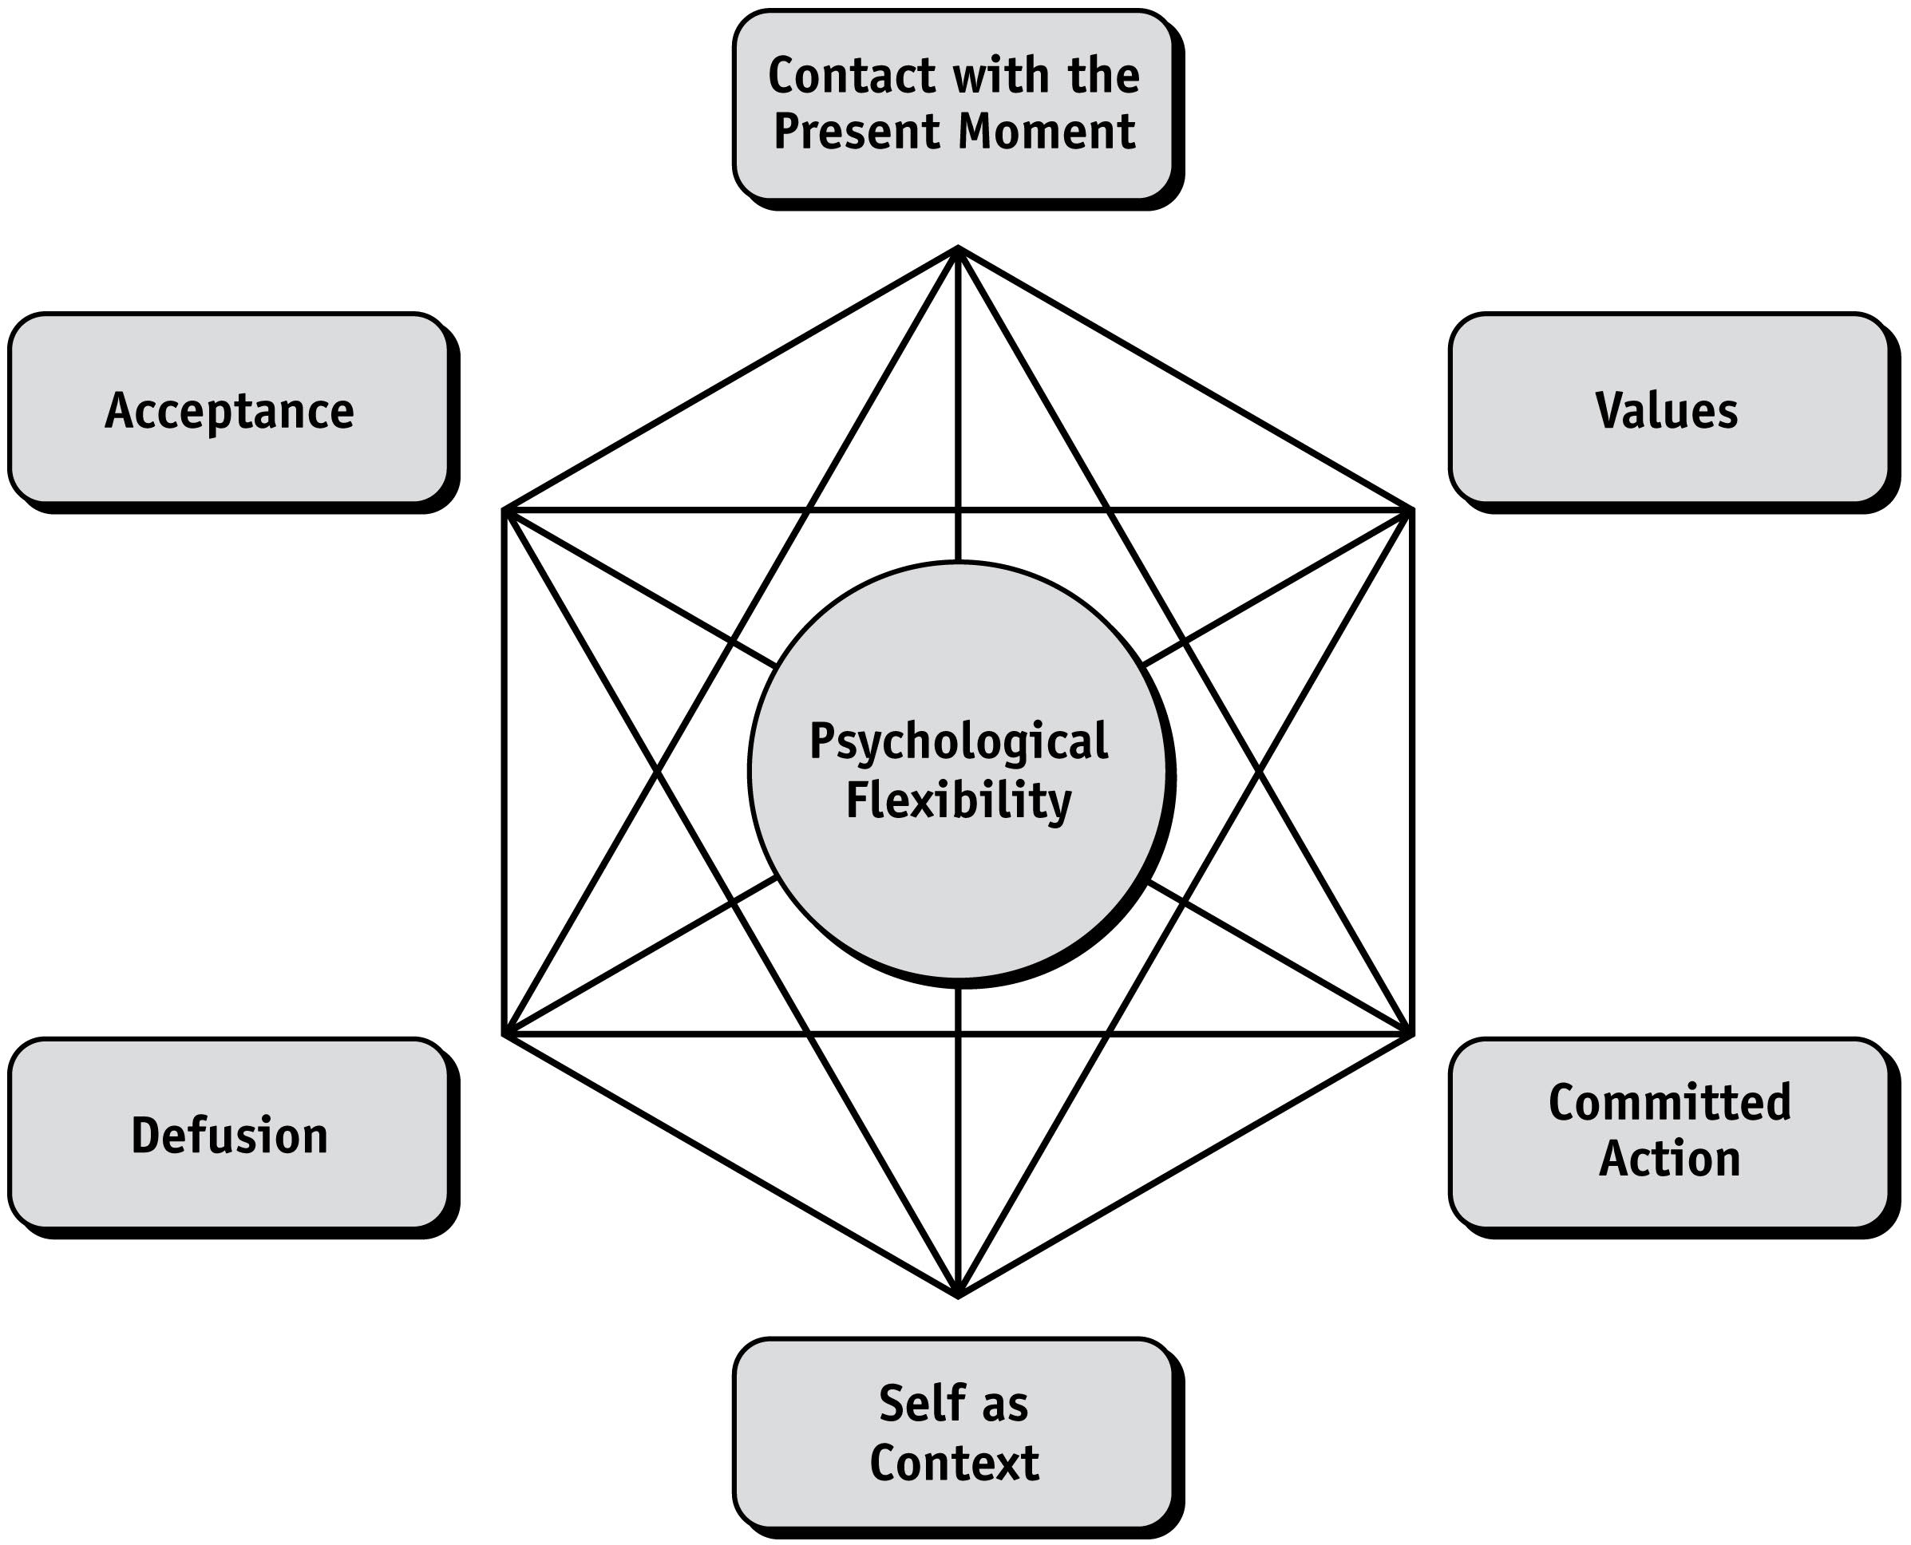
Committed Action is intertwined with all of the other processes on the hexaflex, both facilitating them and being facilitated by them

Slide 7
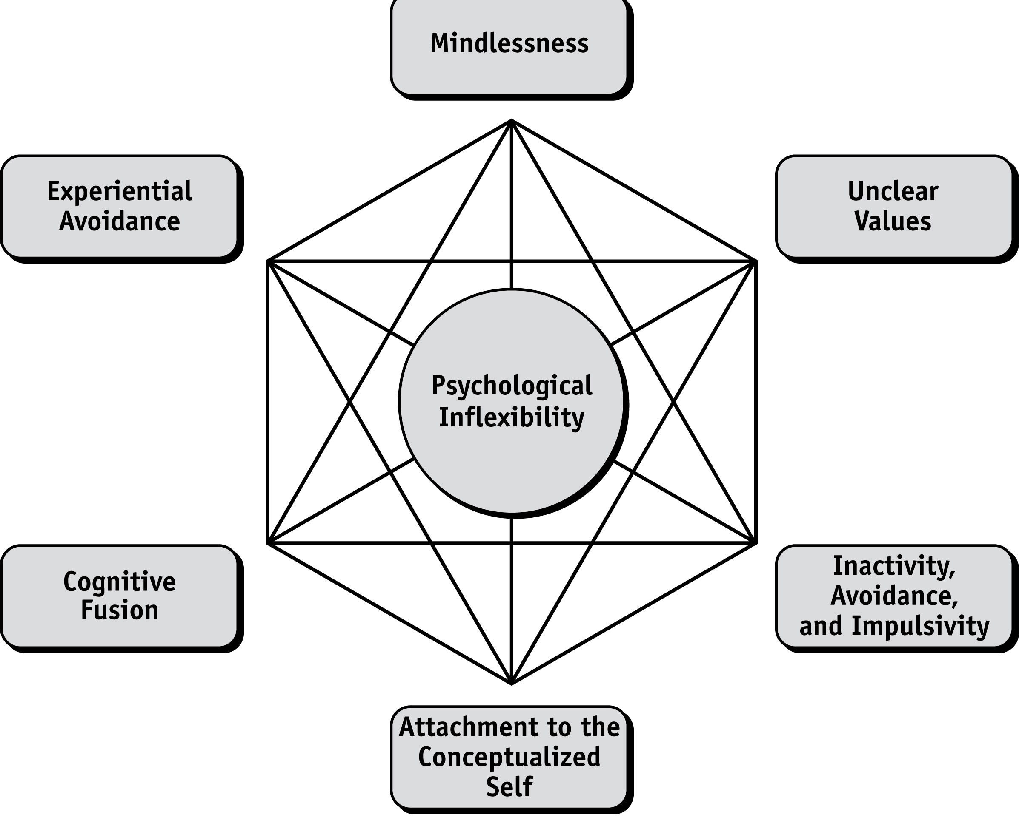
Identifying Obstacles to Committed Action on the Part of the Client: The Inflexahex

Slide 8
Sample obstacles to committed action on the part of the client
“I didn’t feel like it” (experiential avoidance)
“I was too anxious, depressed, angry, etc.” (cognitive fusion)
“I forgot” (mindlessness)
“It didn’t seem important” (unclear values)
“Too many other things seemed more important for me to do” (inactivity, avoidance, and impulsivity)
“I wanted to, but it’s just not for me” (attachment to the conceptualized self)

Slide 9
Additional obstacles to committed action
Lack of environmental supports
Skills deficits

Slide 10
Addressing obstacles to committed action on the part of the client: Committed Action and Acceptance
Clients may:
Want to change private events (e.g., pain, mood) without changing behavior
Want to change behavior without experiencing discomfort (e.g., losing weight, stopping substance use)
Not accept the circumstances that brought them here
Address avoidance and control agenda
Work on small acts of acceptance

Slide 11
Addressing obstacles to committed action on the part of the client: Committed Action and Defusion
Clients may:
Convince themselves they can’t act just yet
Decide they’re doomed to fail
Miss opportunities for committed action if the opportunities don’t fit with the stories they’ve told themselves
Focus on changing other people’s behavior
Classic defusion exercises
Demonstrate the disconnect and lack of power of thoughts on behaviors in session

Slide 12
Addressing obstacles to committed action on the part of the client: Committed Action and Contact with the Present Moment
Clients may:
Focus inordinately on the future
Focus excessively on the past
In the case of depression and worry, focus on both past and future
Go through the day in a mindless state
Committed action can only take place in the present – mindfulness can help
Be mindfulness both of the process of committed action and opportunities to practice it

Slide 13
Addressing obstacles to committed action on the part of the client: Committed Action and Self-as-Context
Clients may:
Get caught up in their stories about who they are
Feel defined by their thoughts, feelings, sensations, history
Believe they can’t act because of their thoughts, feelings, sensations, history
Self-as-context exercises to provide space for new actions (e.g., Observer exercise, I am… , sky with clouds, tree exercise)

Slide 14
Addressing obstacles to committed action on the part of the client: Committed Action and Values
Clients may:
Choose behaviors based on what feels good or avoiding what feels bad
Set goals based on what others want or what they think they are expected to do
Fail to keep values in mind as they have opportunities to choose effective action
Values clarification to identify domains that are personally meaningful
Visualization exercises related to values to charge and inspire actions

Slide 15
Addressing obstacles to committed action on the part of the client: Committed Action and … Committed Action
Clients may:
Become overwhelmed by large goals that seem impossible
Become stuck when trying to start changing longstanding patterns
Choose “dead man goals”
Starting with small committed actions to build larger patterns of committed action
Engaging in many new, interconnected behaviors to build new patterns of behavior

Slide 16
Context and function influence the understanding of committed actions
Taylor has committed to run an average of 30 minutes per day in the service of her value of improving and maintaining her health
Values driven, very easily measurable
However, measurement doesn’t tell the whole story…..

Slide 17
How workable or effective is Taylor’s commitment to run in each scenario?
She often reports that she wants to improve her health, and she is overweight, abuses alcohol, and smokes 10 cigarettes a day
She’s morbidly obese
She’s in treatment for panic attacks and her primary treatment goals are to improve anxiety management skills and find a new job
She’s a triathlete and typically runs 50 miles a week
She’s 62 years old and hasn’t walked more than a mile at a time in over five years
She made the commitment a few days after her sister (her chief rival) made the same commitment

Slide 18
Committed action must be considered in the context of history, presenting complaint, goals, and values. She returns the next week and….
She didn’t run because her physician advised her she should have a complete physical first
She ran 30 minutes one day, skipped the next 5 days, and ran 3 hours on the 7th day
She reports that meeting her goal was easy, because she usually runs 60 minutes a day
She tells you she didn’t run 30 minutes the day after she came down with the flu
She tells you she didn’t run 30 minutes per day because she felt too depressed
She says that even though she was late to work 3 times because of her early morning running that she did keep her commitment

Slide 19
Therapist obstacles to facilitating committed action
Discussion: what gets in your way?

Slide 20
Therapist obstacles to facilitating committed action
Discomfort with being directive / with the process of “homework”
Feeling that it is not compassionate to push someone at times
Mismatch of therapeutic timing – moving too quickly to committed action
Failing to fully explore resistance or barriers
Frustration with listening to a client’s fused stories
Frustration with lack of follow through by the client
Feeling like the therapist doesn’t have enough time to prepare
Therapist feeling stuck in therapy
Therapist well being outside of the therapy room (e.g., burnout, not following through with own committed actions)

Slide 21
Recognizing Therapist Barriers to Committed Action Work: Sticky thoughts
“She’s already dealing with enough right now without me adding more for her to work on.”
“I know he probably won’t follow through anyway.”
“This is so uncomfortable.”
“We talk about the same thing every week, and she just refuses to do anything about it.”
“It’s not fair to him to ask him to do this.”
“She probably won’t be successful in this situation, even if she tries. The circumstances are just too complicated and out of her control.”
“I can’t figure out how to get him unstuck so that he’ll listen to my suggestions.”

Slide 22
Recognizing Therapist Barriers to Committed Action Work: Other Signs
Sticky thoughts can serve as a signal that the therapist is fused with thoughts about the client or the process, rather than simply tracking what’s likely to be effective and being willing to experiment to find what works
Client seems to be frustrated with the therapist for pushing toward commitment
Client demonstrates counterpliance – may be a sign the client is not where the therapist thinks the client is with things
The therapist is the one repeatedly coming up with the committed actions to work on, especially when the client is not following through – the therapist may be gaining agreement through pliance rather than through the client’s values

Slide 23
Overcoming Barriers to the Therapist’s Own Committed Action
When the therapist finds himself at a stuck point, he should examine how well his approach to committed action is working for the client – is the current approach getting the person closer to or further from the client’s goals
Therapists who are giving their clients a “pass” on following through with commitments should reflect on whether they are perhaps costing their clients time and lost opportunities by not following up
If the therapist is fused with unhelpful thoughts or feelings of frustration, it may be time to practice therapist defusion and acceptance and again reconnect with the values of the client (and the therapist!)
Mindfulness of the process can be very useful
When in doubt – bring up the barriers for discussion with the client – thoughtfully and nonjudgmentally

Slide 24
Therapist Barriers to Effective Use of Homework
Homework is an area where both clients and therapists can struggle with committed action
However, without specific plans for applying new behaviors in real life, clients’ commitment to use the skills discussed in therapy can easily fade
So, an important part of ACT is collaborating with clients to choose homework assignments for the week.
Even when everyone understands why homework is useful, following through with homework assignments is easier said than done – for both client and therapist

Slide 25
A Model for Homework in Therapy
The client and therapist collaboratively identify behavioral targets to be met by the client before the next session or within a specific time period
The client and therapist identify potential barriers that are likely to arise and could get in the way of accomplishing the target behaviors, and they develop strategies to address those barriers
The client makes a commitment to follow through with the identified behavioral targets
The client does (or does not) follow through with the planned behaviors
The therapist follows up in the next session to determine whether the client successfully accomplished the homework assignment
If the client followed through, the therapist works to ensure client awareness of and contact with the natural contingencies of the behavior. Or if the client didn’t follow through or did so only partially, the therapist helps the client assess what the barriers were, and together, they make a plan to overcome those barriers in the future

Slide 26
Therapist Barriers to Effective Use of Homework
Sometimes logistical barriers get in the way – client and therapist should both have a written record of the same list of committed action goals at the end of the session, to facilitate follow up
Some therapists are uncomfortable with having a predetermined session structure that sets aside time for follow up on the last session’s homework, and discussion of the committed action goals for the following week
Important to remember this process is for the client’s interests
Just like clients, some therapists may have a negative association with the word or concept of “homework” – can choose other words (e.g., goals, commitments, targets, plans). The therapist may also need consultation
Therapists may get overly invested in the outcome of a given commitment – remember that commitments are only chosen by the client to extend the work of the client’s life and do not reflect on the therapist or quality of therapy

Slide 27
Therapist Barriers to Effective Use of Homework
There are many “reasons” that therapists might not follow up on homework assignments:
Getting caught up in the flow of a session
Staying with what seems to be the client’s priority that day
Deciding it’s more important to stay with an immediate stressor
Avoiding discomfort associated with asking about homework when clients are likely to say that they did not follow through with it
Feeling like an authority figure and worrying that it affects the mutuality of the relationship
However, not following up with something the therapist said they would do can feel unpredictable to the client and make follow through less likely
May be an opportunity for the therapist to practice her own commitment skills
May want to arrange the environment to promote reminders to follow through

Slide 28
Therapist Committed Action During Exposure Therapy
Exposure involves a health dose of commitment on the client’s part, and often on the therapist’s part as well
By its very nature, exposure often evokes difficult or unwanted private experiences for clients – however, it can also be quite difficult for therapists to see their clients in distress during the process of exposure
An effective ACT-based exposure therapist will help clients learn to approach exposures and the related private events with a sense of curiosity and vital engagement – this may also require the therapist to make contact with difficult or potentially disgust-inducing stimuli, while still overtly modeling willingness and committed action
Therapists should remain mindful and present with the challenging content and make sure that they aren’t rushing or shortening the experience due to their own discomfort or worries about the client’s discomfort

Slide 29
Maintaining Therapist Committed Action in the Face of Slips and Relapses
Even when values and commitments are clear to client and therapist, the path forward is rarely linear and direct
Slips, missteps, and relapses are part of the growth process and expected
Therapists must be ready to provide nonjudgmental responses to slips or relapses into old, problematic behaviors
These experiences provide an opportunity for therapists to model the approach to committed action that they’re trying to instill in clients
Such detours provide therapists with an opportunity to highlight the dialectic of letting go of a specific outcome while still committing to active engagement in values-based living
The therapist must be careful to be equally open and responsive whether the client followed through with the commitment or not

Slide 30
In closing
Committed action work can be among the most vital and exciting parts of therapy
When commitments are made and achieved, and both client and therapist can see concrete progress in the client’s life, it can be life affirming and highly reinforcing
However, slips and relapses are an inevitable part of any commitment process
Perfect, error-free execution of committed action is not the goal
The goal is to develop larger and more flexible patterns of values-directed behavior that move the client’s life forward over time
The therapist should discuss this inevitability in order to inoculate against destructive behavior after a given committed action is not achieved
The client should be appropriately prepared for a variety of potential outcomes

Slide 31
In closing
Committed action in practice is much more than just identifying a list of goals and planned behaviors
In order to be successfully implemented, it requires all processes in the hexaflex, along with a strong therapeutic relationship
It also involves creating strong relational frames that link planned committed actions with overarching values that can provide ongoing intrinsic reinforcement
When applied and practiced consistently, committed action interventions can be the key to clients moving their lives forward, both now and in the future

Slide 32
Final commitment for today
Closed eyes……

